Slide 1
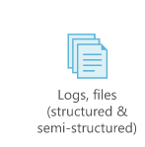




COVID-19 Analytics – High Level Architecture
Http Request
Data Factory
Data Lake
Data Explorer

